Slide 1
Add the title of your school and logo
Add the standard numbers.
Add your name.

Slide 2
Quiz Program using Python Programming Language
Link to github Repository:
Links to trello board / project management tools

Slide 3
Relevant Implications
Implications are the results of actions that we perform.
With relevance to software development life cycle, there are many implications that follow as a result of design, development, usage and effects on people.
The most relevant implications that are directly related to developing the computer program are:
Usability, Functionality, Aesthetics,Social Implication .
I will first describe and explain these implications.
I will address these implications at the end of the completion of my development where I can show the proof of addressing them with screenshots.
Notes:
Explain the relevant implications here. Then as you work, develop your code, discuss how the implications are being met.

Slide 4
Relevant Implication- Usability
Description | Explanation
Usability is closely related to end user experience. Usability is about providing features that the users enjoy while using the program. This is about communicating to users by giving : Instructions, Giving feedback, Recognition than recall Allowing Flexibility and efficiency of use | For example, when we give instructions to user on how to use the program and what actually happens in the series of actions and how the program will meet their need. Another example can be giving feedback to the user by giving good error messages. Even though the priority is to design a program without errors, we should also consider slips and mistakes by users. An example of Recognition than recall is to provide multichoice to users rather than asking question without giving them a choice. Then the chances of them answering quiz will be more. Flexibility is to give the users a choice to choose a method that can speed up the process.

Slide 5
Relevant Implication- Functionality
Description | Explanation
Functionality is about making sure that the program works as expected. This means the way we design a program should match with its performance and meet our expectations. | The program should work for expected, boundary and invalid inputs. When user enters a lower number it should accept but the program should not crash if user enters a 0. For example when a user enters number for the name, the program should not crash but keep giving warning text messages to enter the right name. For example if the age eligibility is set to 15 and user enters 15.1 or 0 program should not crash but give the user another opportunity to enter correctly.

Slide 6
Relevant Implication- Aesthetics
Description | Explanation
Aesthetics is about the presentation of the program to the user in a meaningful and presentable way. This means the program should have good visual appearance which is achieved by good layout. Often users respond well to good aesthetics and consider much more intuitive rather than less intuitive ones. We can always expect user’s return when the presentation is aesthetic and influence their level of learning. | For example we can space out the instructions for easy reading and understanding. We can separate sections by using decorations such as double lines or stars in a row. We can give use the colon and space after asking a question so that question and answer don’t appear like one sentence. A well laid out program code can always bring back the audience to revisit our program.

Slide 7
Relevant Implication- Social
Description | Explanation
Social implication refers to the actions of an individual or groups have on values, demographics or economic conditions. Our choice of making a computer program should not be harmful to the society. The topics for development should be chosen carefully as this may cause discrimination in the socielty. The topics for development may also have a negative effect such as encouraging people to harbour harmful habits. | A good example for this can be choosing the topic for my quiz in a way that is not intending to cause negative effect on a race, culture or the status of the people. My quiz game is intended for challenging and encouraging the users to expand their knowledge on a certain topic rather than making it look like a gambling game. For example making statements such as users from certain countries are better players of math quiz than some others.

Slide 8
Flowchart (of the whole program)
Quiz Task- Decomposition
Ask User’s Details
Give Instructions to Play Quiz
Choose number of rounds
Generate random Quiz Topic Questions
Display whether they are right or wrong
Display score points for their answer
Continue to ask questions
End Game Summary with Stats
Decomposition of the Task into small and manageable components.
Once I have decomposed the task then I can work on each component, test the components for their functionality.
In the end I will assemble the suitable and functional components and create a final version.
I will save all my versions in Github and provide the links.
Notes:
Paste screenshots of your initial Trello board / task decomposition on this slide. If you have a long list, you might need to break it up into several columns. Delete this instruction when you are done.

Slide 9
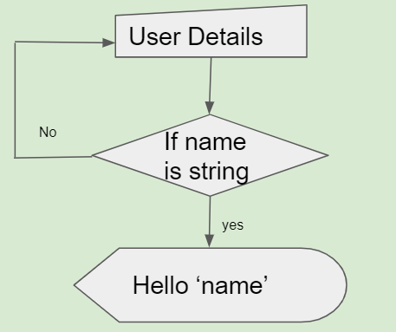
Quiz Task- Decomposition
Ask User’s Details
Give Instructions to Play Quiz
Choose number of rounds
Generate random Quiz Topic Questions
Display whether they are right or wrong
Display score points for their answer
Continue to ask questions
End Game Summary
Flowchart
Ask User Details
Ask user to enter name
Check that the response is valid.
Return name
Check that UPPERCASE input still works

Slide 10
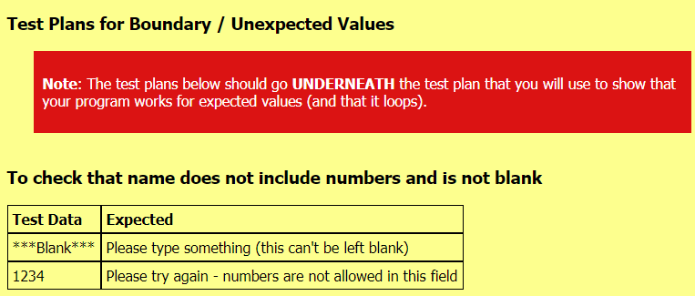
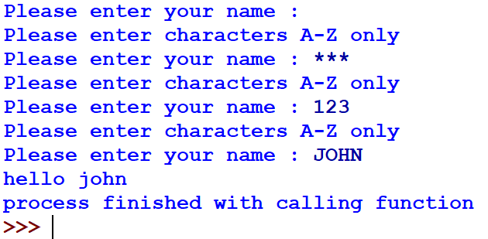
Example of Generating Test plan for name variable using Program Planning Helper
(The program will accept UPPERCASES and alphabets but not numbers.)
Test Data | Expected
(Left blank) | Asks to enter name
123 | Error message pops up and asks the user to enter only text.
JOHN, john,John | Accepted uppercase and converted to lowercase
Question is repeated if <enter > or any invalid data is inputted.
Question is repeated if numbers are entered instead of text.
Converts uppercase to lower case.

Slide 11
Quiz Task- Decomposition
Ask User’s Details
Give Instructions to Play Quiz
Choose number of rounds
Generate random Quiz Topic Questions
Display whether they are right or wrong
Display score points for their answer
Continue to ask questions
End Game Summary
Flow Chart
Do you need Instructions to play
Yes
Print Instructions
Ask if the user need instructions
If user answers ‘Yes’
Print Instructions
Else
Welcome to game
No
Welcome to Quiz Game

Slide 12
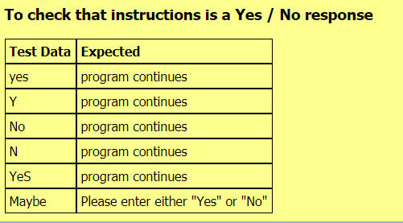
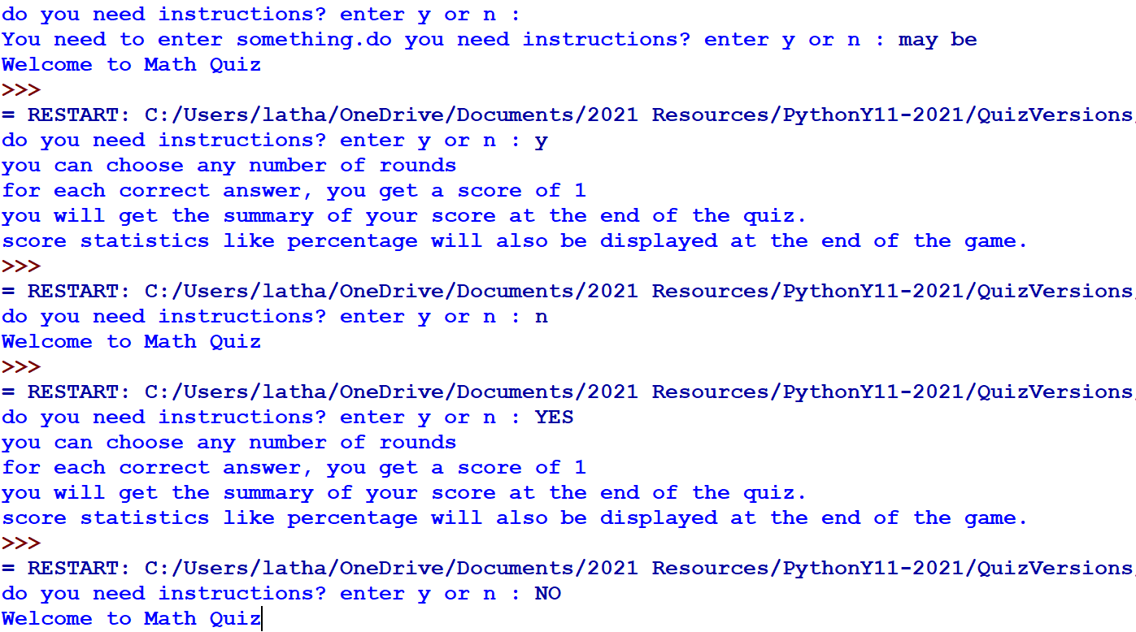
Generating Test plan for Instructions with yes /no variables using Program Planning Helper
(The program will accept lower case yes/no as well and also just alphabets.)
Below is result from python shell
Prints instructions
User Choice for getting Instructions
Test Data | Expected
yes | Program continues
Y | Program continues
No | Welcomes to Math Quiz
N | Welcomes to Math Quiz
Maybe | Asks to enter yes or no
<Blank> | Asks to enter yes or no
Prints welcomes to quiz
If user answers may be , program asks user to enter something.
If user answers may be , program asks user to enter something.

Slide 13
Instructions Trialling.
Trial #1: I have initially used only one function called def instructions(). This prints just the instructions.
Trial #2: I have later added another function called def instruction_choice(). This will address various ways of user inputs such as:
Yes
yes
No
no
Leaving Blank
Entering May be
I have used if...elif conditions
Used lists to store the input choices of user.

Slide 14
Quiz Task- Decomposition
Ask User’s Details
Give Instructions to Play Quiz
Choose number of rounds- Range
Generate random Quiz Topic Questions
Display whether they are right or wrong
Display score points for their answer
Continue to ask questions
End Game Summary
Flowchart
Enter range
If
Ask user to enter range(number of rounds)
If range entered as integer- True Displays quiz questions
If range entered as string- Loop back and ask range again
string
Integer
Display quiz question

Slide 15
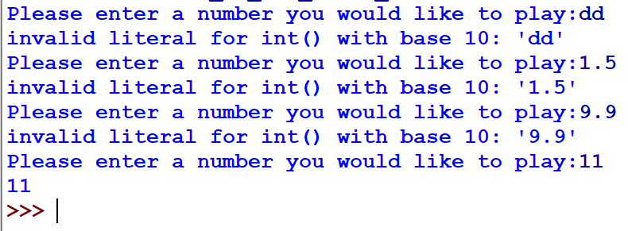
Get Range Test plan 1 and Test Results
Test Data | Expected
XLII | Error message
0 | Repeats question
10.5 | Error message. Repeats question
11 | Error message Repeats question
1 | Accepted
10 | Accepted
Test Results from Shell

Slide 16
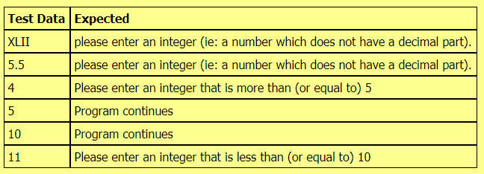
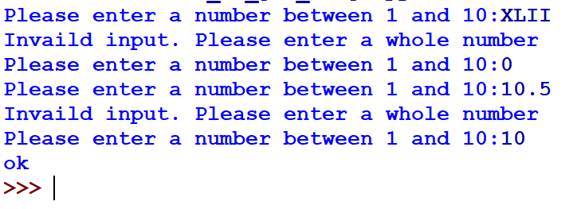
Get Range Test plan 2 and Test Results
Program Planner
Get Range: Screenshots from Shell
Test Data | Expected
XLII | Error message
0 | Repeats question
10.5 | Error message. Repeats question
11 | Error message Repeats question
1 | Accepted
10 | Accepted
Error message
Does not accept decimals. Error message
Accepts highest number in range and program closes.
Accepts lowest number in range and program closes.
Does not accepts higher than range and repeats question.

Slide 17
Get Range trialling
Trial #1 - this part of quiz will accept any integer from user that a user would like to play.
Trial #2 - This code uses Try and Except, which rejects out of range(higher or lower) and also rejects decimal and roman numbers and prompts users to enter numbers between 1 and 10.
Trial 2 is an improvised version and will be used in the final assembling as it can handle a range of valid and invalid inputs from user.

Slide 18
Quiz Task- Decomposition
Ask User’s Details
Give Instructions to Play Quiz
Choose number of rounds
Generate random Quiz Topic Questions
Compare user answer with dict answer
Display score points for correct answer and display wrong for wrong answer
Continue to ask questions
End Game Summary with Stats
Generate Random Quiz Topic Questions
Reads questions randomly from dictionary in any order
Uses randint for integer a
Uses randint for integer b
Uses operators like +,-,x

Slide 19
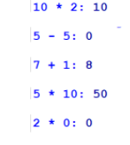
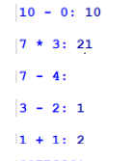
Get Random Questions (Plan and Testing)
Test Data | Expected
Randomly generate number of items as per user’s range items | The order should be random each time.
 | Random order (second time) Different questions are displayed every time with Random import library.

Slide 20
Quiz Task- Decomposition
Ask User’s Details
Give Instructions to Play Quiz
Choose number of rounds
Generate random Quiz Topic Questions
Compare user answer with dict answer and give user feedback
Continue to ask questions
End Game Summary with Stats
Compare user answer with dict answer
Iterate through each question
Compare user answer with dictionary answer
Give feedback
Give score

Slide 21
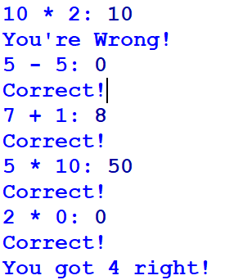
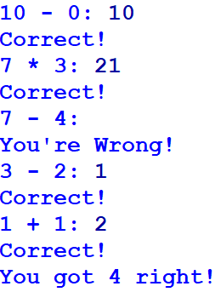
Compare User answers (Test Plan) Round 1
Compare User answers (Test Plan) Round 2
Test Data | Expected
10*2 = 10 | Wrong
5-5 =0 | Correct
7+1 = 8 | Correct
5*10 = 50 | Correct
2 *0 = 0 | Correct
Test Data | Expected
10-0= 10 | Wrong
7*3=21 | Correct
7-4 = | Wrong
3-2=1 | Correct
1+1=2 | Correct

Slide 22
Comparison Trialling...
I realised that if user is not answering a question, the program is displaying as wrong.
I would like to correct this and make changes to the code so that if user leaves the question blank to prompt user if he wants to continue or quit.

Slide 23
Quiz Task- Decomposition
Ask User’s Details
Give Instructions to Play Quiz
Choose number of rounds
Generate random Quiz Topic Questions
Compare user answer with dict answer and give user feedback
End Game Summary with Stats
Ask user if they want to continue or quit. Loop back to choose number of rounds
End Game Summary
Score for each question
Display number of right answers
Display number of wrong answers
Display Score
Display score statistics

Slide 24
Emergency Exit Justification (and more trialling)
The game has been set up so that if users enter ‘xxx’ as their choice, the game will end, even if they previously asked for a given number or rounds. This option will be explained in the ‘introduction’ section
Allowing users to exit the game early addresses the Usability implication. Having this ‘emergency exit’ is good use of the User Freedom heuristic. The exit code has been chosen so that users are unlikely to choose it by accident.
I will need to adjust my string checker function so that if users enter ‘xxx’, that is accepted as a valid option (but ‘x’ is not).j

Slide 25
Assembled Python Quiz - Output Trialling

Slide 26
Assembled Game Test plan (expected values)
Test Case | Expected

Slide 27
Assembled Game Test plan (unexpected & Boundary values)
Test Case | Expected

Slide 28
Assembled Python Quiz Testing - Video(unexpected / boundary values)

Slide 29
Version Control Evidence
Github was used as the version control system for this project. I committed each component as it was completed and systematically combined components to develop the working outcome. Here is a screenshot of my github activity...
Here is the version control evidence for my assembled program. Each node in the diagram below represents an updated version of the code.
Notes:
Your version control evidence should go here. This could be in the form of annotated screenshots which show you you managed this process or you could make a brief screencast explaining how you implemented version control.

Slide 30
RPS - Relevant Implications
I addressed the functionality implications by comprehensively testing my code and ensuring that it works for expected, boundary and unexpected values.
The program is easy to use as it has clear error messages and will accept a range of inputs (eg: y / n / yes / no). If users enter invalid data, they are usually told what they should enter when the question is repeated.
The aesthetics implication has been addressed by the careful use of spacing and the statement generator function which has been used from time to time to emphasise output.

